Slide 1
Location-based Recommender System
Ravuri Amritha Vardhini - 141112084
Siva Likitha Valluru - 141112009
Kanchan Chauhan - 141112285
Suneel Kumar Jatav - 141112264

Slide 2
Content
Problem definition
Purpose
Problem formulation
Modules and descriptions
Result analysis
Applications
Tools and technology
Conclusions
References

Slide 3
Problem Definition
A​ recommendation system is a software program which attempts to narrow down selections for users based on their expressed preferences, past behavior, or other data which can be mined about the user or other users with similar interests. It ​is a subclass of ​information filtering system​ that seeks to predict the "rating" or “preference" that a user would give to an item.
This project integrates a recommender system to implement a location-based GPS system and suggest​ ​an​ ​optimal​ ​path​ ​sequentially​ ​for​ ​a​ ​series​ ​of given pick-up points

Slide 4
Purpose
The purpose of this project is to analyze the parameters that a location-based recommender system will use and thus, increase the accuracy of the recommendations. One of the main challenges while implementing a mobile recommender system is dealing with computation power which is exponentially growing due to fluctuating, huge, and sparse real-time data.

Slide 5
Problem Formulation
The problem here is known as mobile sequential recommendation (MSR). The input for MSR consists of a set of parameters: a set of plausible pick-up points C1, C2, C3,...,CN, a set of probabilities P(C1), P(C2), P(C3),..., P(CN), where P(CN) refers to the probability of finding a customer at location CN, and position of the cab driver at PoCab.

Slide 6
Problem Formulation
There is another function we take into account when designing MSR. The Potential Travel Distance (PTD) is introduced. PTD observes each pick-up point’s probability by looking at past events. If there are no events of customers getting inside a cab for a certain pick-up point, then its probability will be zero. In case of small number of data points, PTD function will yield results quickly. However, in terms of large data, analyzing all of the points is time-consuming. Therefore, it will require lots of processing power.

Slide 7
Problem Formulation
To avoid computational power, a constraint, L, is added. It is practically not possible to search for an optimal solution of the general MSR problem because this problem requires an unreasonable amount of computation. L stands for length and is used to suggest an optimal route. Instead of suggesting an optimal path by traversing through all of the pick-up points (similar to Travelling Salesman Problem (TSP)), only L number of pick-up points are used in the suggested sequential route.

Slide 8
Modules and Descriptions
There are seven modules in this project:
Datasets and preprocessing
Clustering based on density of pick-up points
Calculation of centroids
Probabilistic calculation
Pairwise driving distance calculations
Offline pruning
Online pruning

Slide 9
Module 1: Datasets and Preprocessing
Datasets consist of 512 files. Each file contains location traces of a unique cab driver. Each file has around 20,000 records and measures the places that the cab driver visited in 30 days in the city of San Francisco, California. There are four parameters to each record. The first two parameters include the latitude and longitude respectively. The third parameter is the operational status where 0 indicates that the cab is empty and 1 indicates that the cab has at least one passenger. The last parameter is a Unix timestamp (Unix Epoch time).

Slide 10
Module 1: Datasets and Preprocessing
The dataset is pruned using two parameters. The third parameter, operational status, is studied and analyzed for each and every unique cab driver. Next, the last parameter, the location trace timestamp, is used. Since each file already has records in descending order, the range of the number of hours travelled by the cab driver is calculated by considering the maximum and minimum timestamps. If the average of the operational status of all location traces is greater or equal to 0.5 and if the number of hours that each driver travelled is greater than or equal to 500, then this cab driver is labelled a successful cab driver.

Slide 11
Module 2: Clustering based on density of pick-up points
DBSCAN algorithm is used for clustering those pick-up points. There are four input parameters to the algorithm: epsilon (ε), minimum number of samples to be taken, algorithm, and metric.
Epsilon is the radius distance from a pick-up point. Minimum number of samples to be taken, min_Points, represents the number of points that should be present with the specified distance, ε. The third input is algorithm. The specified algorithm is called ball tree algorithm. This distance metric used is Haversine distance or also known as great-circle distance.

Slide 12
Module 2: Clustering Based on Density of Pick-up Points
DBSCAN algorithm is used for clustering those pick-up points. There are four input parameters to the algorithm: epsilon (ε), minimum number of samples to be taken, algorithm, and metric.
Epsilon is the radius distance from a pick-up point. Minimum number of samples to be taken, min_Points, represents the number of points that should be present with the specified distance, ε. The third input is algorithm. The specified algorithm is called ball tree algorithm. This distance metric used is Haversine distance or also known as great-circle distance.

Slide 13
Module 3: Calculation of Centroids
DBSCAN clustering is applied over 15808 pick-up points. The result gave five clusters, not counting outliers. Using all 15808 points as potential pick-up points is not a feasible choice. Therefore, the centroids of the five clusters are taken as potential pick-up points.

Slide 14
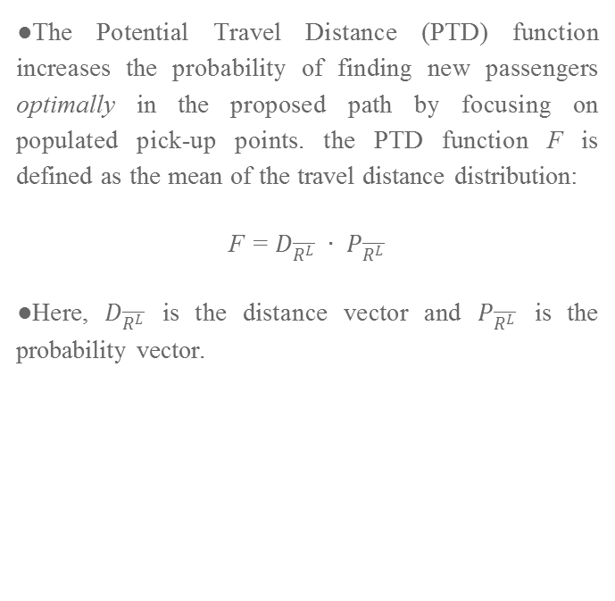
Module 4: Probabilistic Calculations
The Potential Travel Distance (PTD) function increases the probability of finding new passengers optimally in the proposed path by focusing on populated pick-up points. the PTD function F is defined as the mean of the travel distance distribution:
F = $D_{\overline{R^{L}}} ∙ P_{\overline{R^{L}}}$
Here, $D_{\overline{R^{L}}}$ is the distance vector and $P_{\overline{R^{L}}}$ is the probability vector.

Slide 15
Module 4: Probabilistic Calculations
The probabilities are calculated to measure how the success of each pick-up point, i.e, the profit a pick-up profit can bring. The parameters in the input are the number of empty cabs and the number of pick-up events. Let ​#r ​ denote the number of empty cabs and ​#p ​ denote the number of pick-up events.
The probability,​ ​​P(Ci), ​ ​​ is​ ​calculated​ ​by:
P(Ci) ​ ​ = ​ ​ #p/#r, ​ ​ where ​ ​ 1 ​ ​ < ​ ​ i ​ ​ < ​ ​ N
Here,​ ​​#p ​ ​​ and​ ​​#r ​ ​​ are​ ​calculated​ ​for​ ​each​ ​pick-up​ ​event​ ​at​ ​different​ ​time​ ​periods.

Slide 16
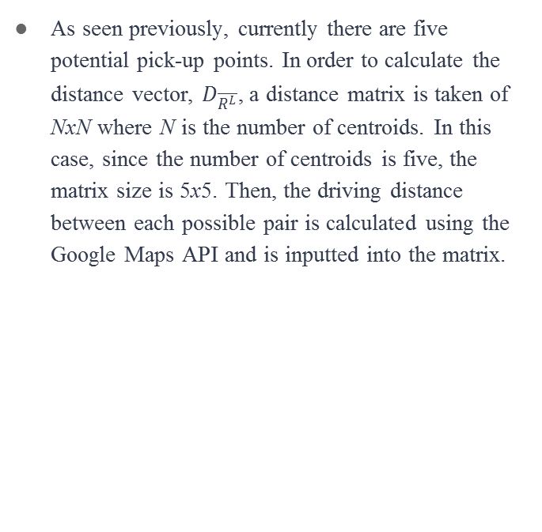
Module 5: Pairwise Driving Distance Calculations
As seen previously, currently there are five potential pick-up points. In order to calculate the distance vector, $D_{\overline{R^{L}}}$, a distance matrix is taken of NxN where N is the number of centroids. In this case, since the number of centroids is five, the matrix size is 5x5. Then, the driving distance between each possible pair is calculated using the Google Maps API and is inputted into the matrix.

Slide 17
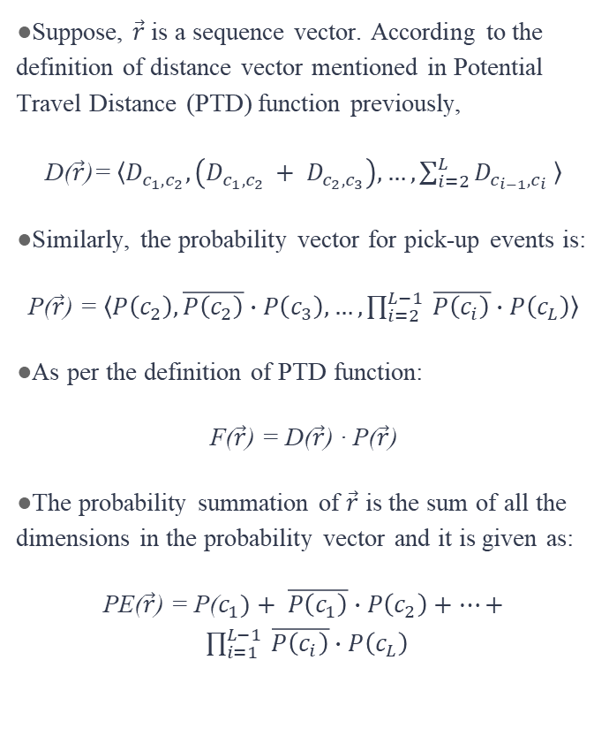
Module 6: Offline Pruning
Suppose, $\vec{r}$ is a sequence vector. According to the definition of distance vector mentioned in Potential Travel Distance (PTD) function previously,
D($\vec{r}$)= $〈D_{c_{1}, c_{2}}, \left(D_{c_{1}, c_{2} }+ D_{c_{2}, c_{3}}\right), …, \sum_{i=2}^{L}{D_{c_{i−1}, c_{i}}} 〉$
Similarly, the probability vector for pick-up events is:
P($\vec{r}$) = $〈P\left(c_{2}\right), \overline{P\left(c_{2}\right)}∙P\left(c_{3}\right), …, \prod_{i=2}^{L−1}{ \overline{P\left(c_{i}\right)}∙P\left(c_{L}\right)}〉$
As per the definition of PTD function:
F($\vec{r}$) = D($\vec{r}$) · P($\vec{r}$)
The probability summation of $\vec{r}$ is the sum of all the dimensions in the probability vector and it is given as:
PE($\vec{r}$) = P($c_{1})+ \overline{P\left(c_{1}\right)}∙P\left(c_{2}\right)+…+ \prod_{i=1}^{L−1}{ \overline{P\left(c_{i}\right)}∙P\left(c_{L}\right)}$

Slide 18
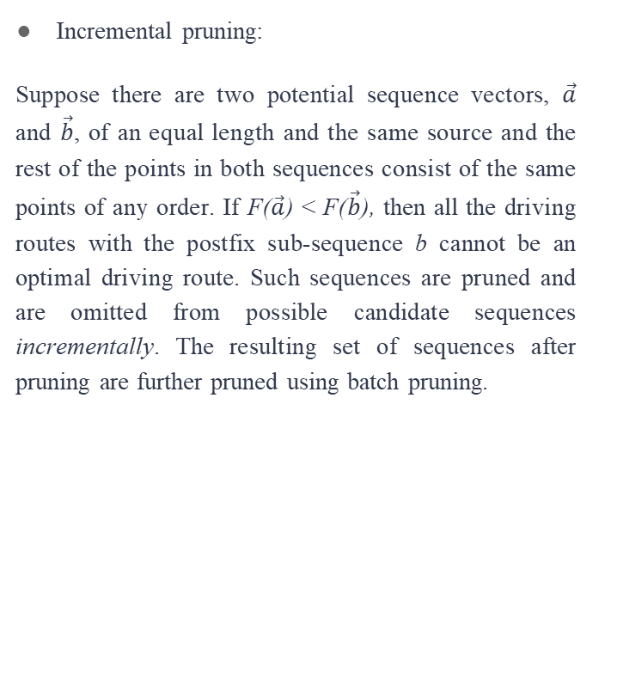
Module 6: Offline Pruning
Incremental pruning:
Suppose there are two potential sequence vectors, $\vec{a}$ and $\vec{b}$, of an equal length and the same source and the rest of the points in both sequences consist of the same points of any order. If F($\vec{a}$) < F($\vec{b}$), then all the driving routes with the postfix sub-sequence b cannot be an optimal driving route. Such sequences are pruned and are omitted from possible candidate sequences incrementally. The resulting set of sequences after pruning are further pruned using batch pruning.

Slide 19

Module 6: Offline Pruning
Batch pruning:
Suppose there are two potential sequences, $\vec{a}=〈c_{s}, c_{a_{1}}, …, c_{a_{k}}〉$ and $\vec{b}=〈c_{s}, c_{b_{1}}, …, c_{b_{k}}〉$, with equal length and same source. If F($\vec{a}$) < F($\vec{b}$), $\vec{b}$ is not the optimal driving route. Thus, $\vec{b}$ should be pruned from the sequence candidates.

Slide 20
Module 7: Online Pruning
In online pruning, the initial position of the cab driver, PoCab, is given. Online pruning provides a driving route recommendation service for empty cabs at any dynamic position. A cab at position PoCab is denoted by c_0 and when this cab requests the recommendation service, the online pruning algorithm is used to find an optimal driving route from the remaining potential sequence candidates generated in offline pruning.

Slide 21
Module 7: Online Pruning
Two more inputs are given: L_min and L_max, where L_min is the minimum number of pick-up points the driver intends to travel and L_max is the maximum number of pick-up points. The potential driving routes are generated by connecting c_0 with the prescribed length L with each potential sequence candidate generated in the offline pruning stage. Then, for each potential route, PTD is calculated.
The minimum PTD value along with the driving route(s) are selected and returned to the user.

Slide 22
Result Analysis
The recommender system requires existing data in order to learn and adapt. Prior data simply refers to the routes previously taken by drivers. In case the driver is new to the city, then there will be no prior data from a driver’s perspective. In that case, prior data can be downloaded from a server where data is from different and unique cab drivers. This data should be trained and later recommended to the driver. Therefore, one of the major challenges in implementing this system would be finding ample and sufficient amounts of true data. Many records of data will be needed to test the software.

Slide 23
Result Analysis
The clusters based on density along with their centroids are displayed on Google Maps using Google Maps API. Centroids are displayed in larger black circles.
After implementing the proposed algorithm, the output is displayed in the form of a list. The output will be the recommended and optimal driving route(s) that is displayed to the cab driver.

Slide 24
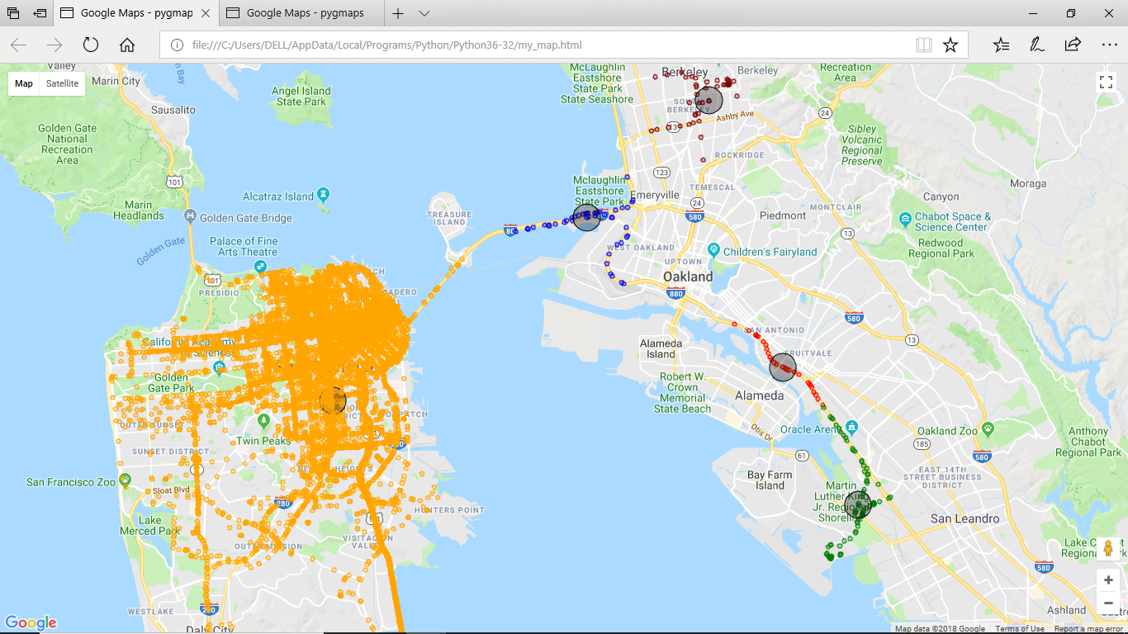

Slide 25
Applications
One application of this system can be seen during school bus transportations. For example, while picking up children who live a few miles away from school, the application can help the bus driver by providing​ ​the​ ​optimal​ ​bus​ ​route.
Another application of this system can be related to home deliveries. For example, a pizza delivery boy could efficiently deliver all the pizza deliveries to various places in the city by using this approach.

Slide 26
Tools and Technology Used
SOFTWARE
Operating​​ ​​​ ​System: Microsoft​​ ​​​ ​Windows​ ​10/8/7​ ​(32​ ​or​ ​64​ ​bit)
Programming​​ ​​​ ​Language:​​ ​Java​ ​8.x and Python 2.x or above
Software: Eclipse and Python’s IDLE
HARDWARE
CPU:​​ ​IntelCore​ ​i5​ ​processor
RAM:​​ ​3GB​ ​minimum,​ ​4GB​ ​recommended
System type: 64-bit OS, x64-based processor

Slide 27
Conclusion
In recent years, there have been several other research papers with a similar proposal.In this research, clustering is used to improve accuracy. The MSR problem is different from the traditional TSP problem. An interesting distinguishment between the both is that source and destination are both known in advance for traditional shortest path algorithms. In MSR, however, both source and destination are unknown.
However, this algorithm has trouble handling the data due to the large number of pick-up points. Therefore, many authors attempted to provide an optimized solution for MSR by setting a constraint. Constraints are set to reduce the search space.

Slide 28
References
[1] Software Engineering Paradigms And Models Information Technology Essay. [Online]. Available: https://www.uniassignment.com/essay-samples/information-technology/software-e ngineering-paradigms-and-models-information-technology-essay.php. [Accessed: 06-Nov-2017].
[2] Huang,J., Huangfu, X., Sun, H., Cheng, H.and Song,Q.(2013). Backward Path Growth for Efficient Mobile Sequential Recommendation. [online] pp.1-28. Available at: https://arxiv.org/pdf/1304.2144.pdf​ ​[Accessed​ ​4​ ​Nov.​ ​2017].
[3] Ge, Y., Xiong, H., Tuzhilin, A., Xiao, K., Gruteser, M. and Pazzani, M. (n.d.). An Energy-Efficient​ ​Mobile​ ​Recommender​ ​System.​ ​pp.1-9.

